Slide 1
Machine Learning Neural Network & Tensorflow & Keras
Dr. Malak Abdullah
Computer Science Department
Jordan University of Science and Technology

Slide 2
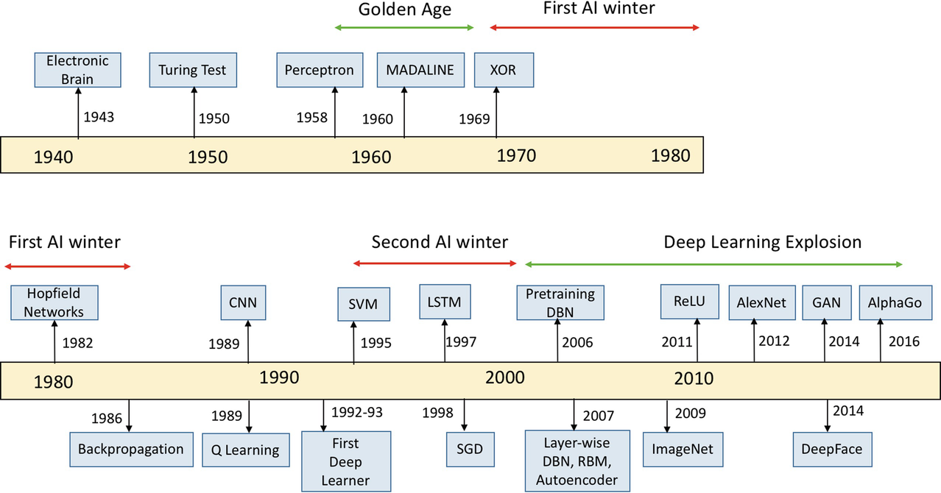

Slide 3
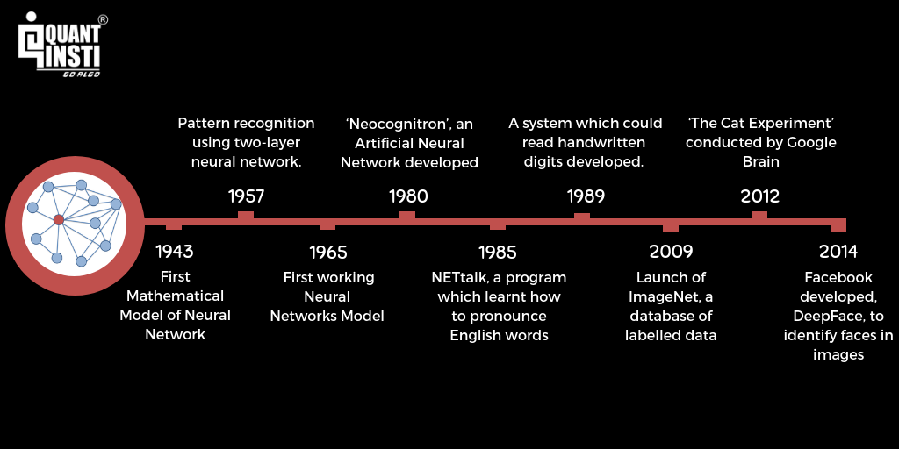

Slide 4
Neural Network again!
The idea of Neural Network has been around since the 1940's, and has had a few ups and downs, most notably when compared against the Support Vector Machine (SVM).
For example, the Neural Network was popularized up until the mid 90s when it was shown that the SVM, using a new-to-the-public (the technique itself was thought up long before it was actually put to use) technique, the "Kernel Trick," was capable of working with non-linearly separable datasets.
With this, the Support Vector Machine catapulted to the front again, leaving neural nets behind and mostly nothing interesting until about 2011, where Deep Neural Networks began to take hold and outperform the Support Vector Machine, using new techniques, huge dataset availability, and much more powerful computers.

Slide 5
Why NNs are getting powerful now!?
There is now a huge quantity of data available to train neural networks, and ANNs frequently outperform other ML techniques on very large and complex problems.
The tremendous increase in computing power since the 1990s now makes it possible to train large neural networks in a reasonable amount of time. This is in part due to Moore’s law (the number of components in integrated circuits has doubled about every 2 years over the last 50 years), but also thanks to the gaming industry, which has stimulated the production of powerful GPU cards by the millions. Moreover, cloud platforms have made this power accessible to everyone.
The training algorithms have been improved. To be fair they are only slightly different from the ones used in the 1990s, but these relatively small tweaks have had a huge positive impact.
ANNs seem to have entered a virtuous circle of funding and progress. Amazing products based on ANNs regularly make the headline news, which pulls more and more attention and funding toward them, resulting in more and more progress and even more amazing products.

Slide 6
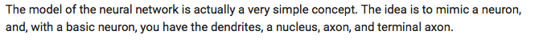
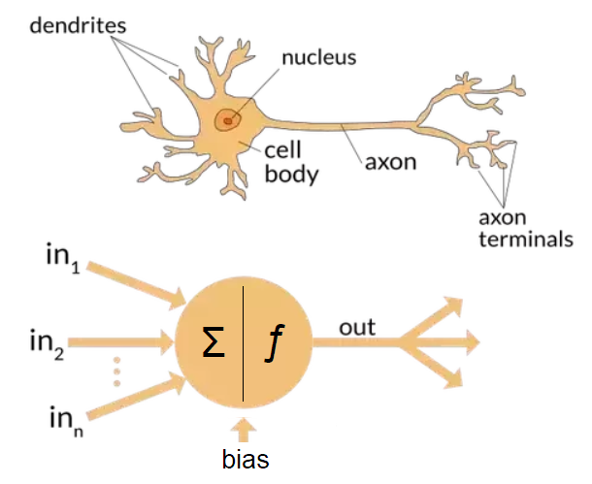

Biological Neurons
Biological neurons produce short electrical impulses as signals, which travel along the axons and make the synapses release chemical signals. When a neuron receives a sufficient amount of these signals within a few milliseconds, it fires its own electrical impulses.

Slide 7
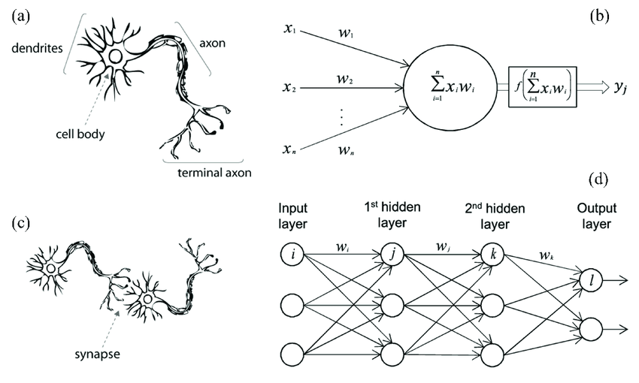
Each neuron typically connected to thousands of other neurons. Highly complex computations can be performed by a network of fairly simple neurons. It seems that neurons are often organized in consecutive layers.

Slide 8
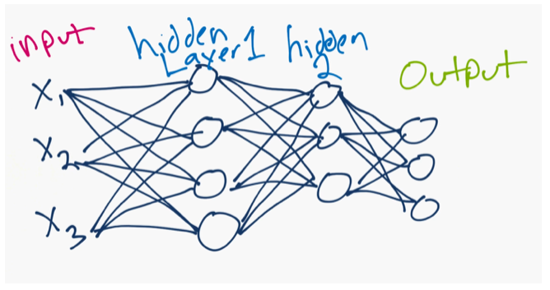
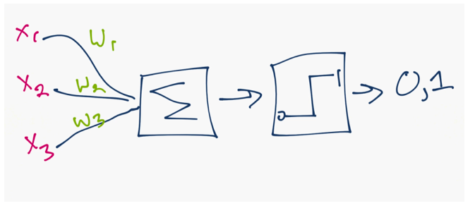
What is Neural Network
With approximately 100 billion neurons, the human brain processes data at speeds as fast as 268 mph!
A neural network is a collection of neurons connected by synapses.
This collection is organized into three main layers: the input layer, the hidden layer, and the output layer.
The circles represent neurons while the lines represent synapses.
Each layer using the output of the previous layer as its input.

Slide 9
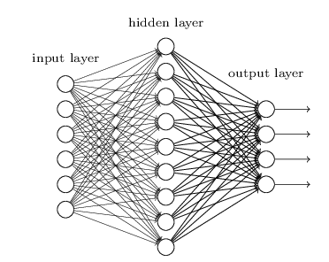
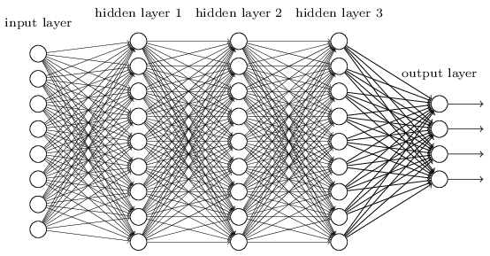
Deep Learning
You can have many hidden layers, which is where the term deep learning comes into play.
In an artificial neural network, there are several inputs, which are called features, and produce a single output, which is called a label.
Neural Network
Deep Learning

Slide 10
Deep Learning (continue)
Deep learning is a machine learning technique that teaches computers to do what comes naturally to humans: learn by example.
Deep learning is getting lots of attention lately and for good reason. It’s achieving results that were not possible before.
In deep learning, a computer model learns to perform classification tasks directly from images, text, or sound. Deep learning models can achieve state-of-the-art accuracy, sometimes exceeding human-level performance.
Models are trained by using a large set of labeled data and neural network architectures that contain many layers.
Deep learning is a key technology behind driverless cars, enabling them to recognize a stop sign, or to distinguish a pedestrian from a lamppost.

Slide 11
Why Now?
While deep learning was first theorized in the 1980s, there are two main reasons it has only recently become useful:
Deep learning requires large amounts of labeled data. For example, driverless car development requires millions of images and thousands of hours of video.
Deep learning requires substantial computing power. High-performance GPUs have a parallel architecture that is efficient for deep learning. When combined with clusters or cloud computing, this enables development teams to reduce training time for a deep learning network from weeks to hours or less.
Deep learning is being used in automated hearing and speech translation. For example, home assistance devices that respond to your voice and know your preferences are powered by deep learning applications.
https://youtu.be/b3IyDNB_ciI?t=42

Slide 12
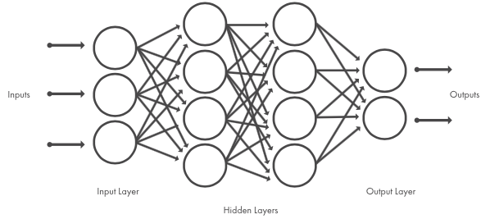
How it functions!?
Deep learning models are trained by using large sets of labeled data and neural network architectures that learn features directly from the data without the need for manual feature extraction
Deep learning is a specialized form of machine learning. A machine learning workflow starts with relevant features being manually extracted from images. The features are then used to create a model that categorizes the objects in the image. With a deep learning workflow, relevant features are automatically extracted from images. In addition, deep learning performs “end-to-end learning” – where a network is given raw data and a task to perform, such as classification, and it learns how to do this automatically.
In machine learning, you manually choose features and a classifier to sort images. With deep learning, feature extraction and modeling steps are automatic.
When choosing between machine learning and deep learning, consider whether you have a high-performance GPU and lots of labeled data. Deep learning is generally more complex, so you’ll need at least a few thousand images to get reliable results.

Slide 13
How to Create and Train Deep Learning Models
To train a deep network from scratch, you gather a very large labeled data set and design a network architecture that will learn the features and model. This is good for new applications, or applications that will have a large number of output categories. This is a less common approach because with the large amount of data and rate of learning, these networks typically take days or weeks to train.
Transfer learning is a technique where a deep learning model trained on a large dataset is used to perform similar tasks on another dataset.
Transfer Learning: Most deep learning applications use the transfer learning approach, a process that involves fine-tuning a pretrained model. You start with an existing network, such as AlexNet or GoogLeNet, and feed in new data containing previously unknown classes. After making some tweaks to the network, you can now perform a new task, such as categorizing only dogs or cats instead of 1000 different objects. This also has the advantage of needing much less data (processing thousands of images, rather than millions), so computation time drops to minutes or hours.

Slide 14
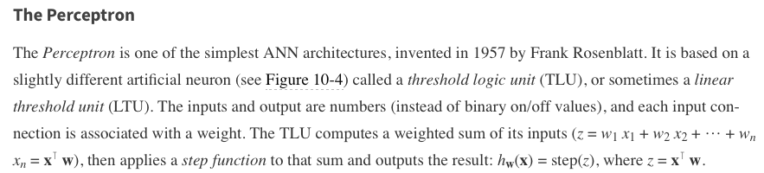
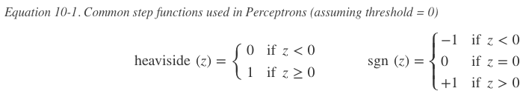
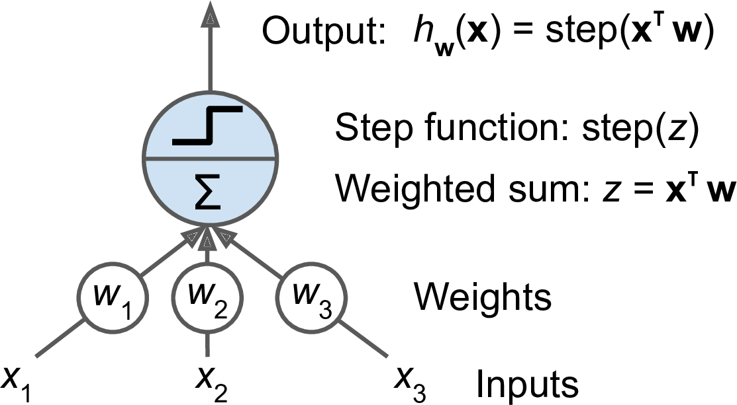
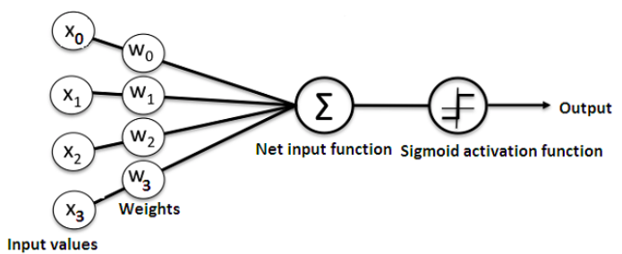
Based on LTU or TLU
Figure 10-4. Threshold logic unit: an artificial neuron which computes a weighted sum of its inputs then applies a step function

Slide 15
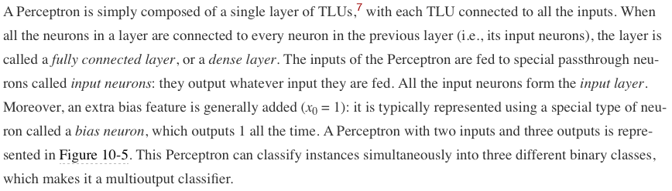
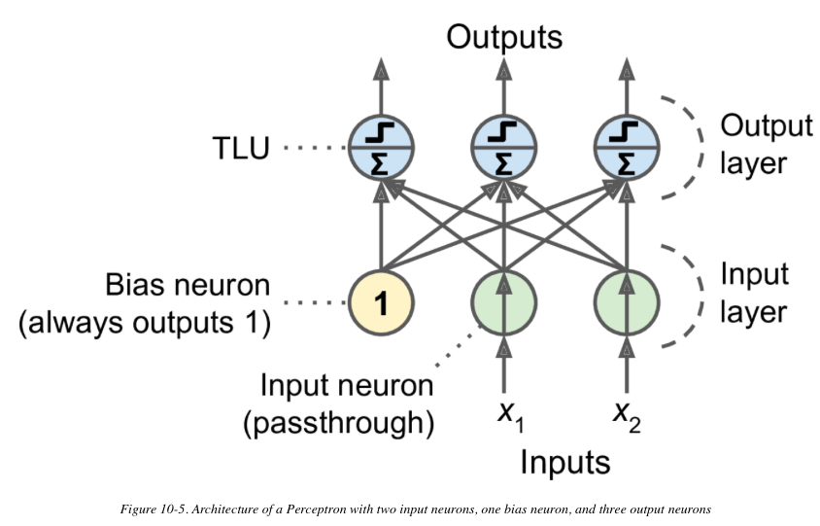
A single perceptron

Slide 16
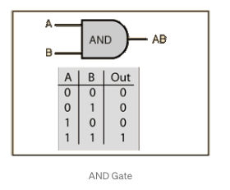
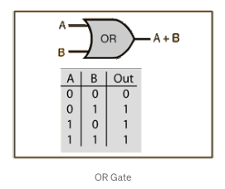
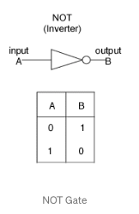
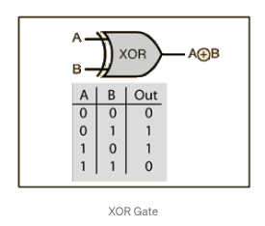
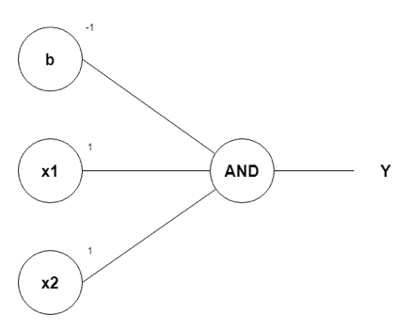
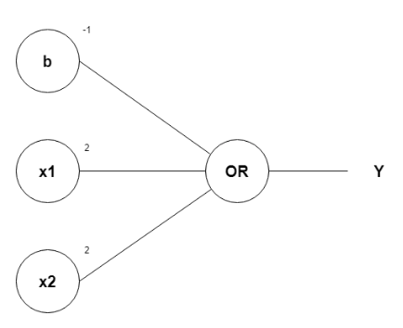
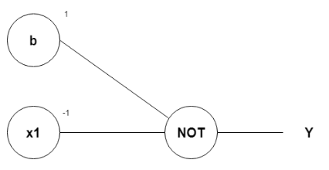
Logical Computations with Neurons
w1, w2, as 1 and b as –1
w1, w2, as 1 and b as –1
?

Slide 17
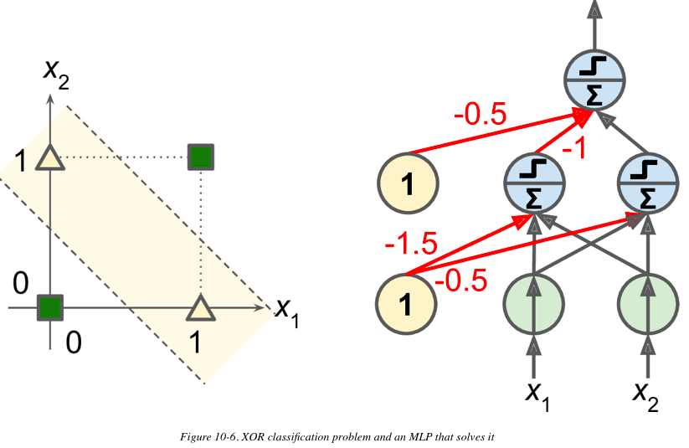
Weakness of Perceptron
In their 1969 monograph Perceptrons, some researchers highlighted a number of serious weaknesses of Perceptrons—in particular, the fact that they are incapable of solving some trivial problems (e.g., the Exclusive OR (XOR) classification problem)
It turns out that some of the limitations of Perceptrons can be eliminated by stacking multiple Perceptrons. The resulting ANN is called a Multilayer Perceptron (MLP).
An MLP can solve the XOR problem

Slide 18
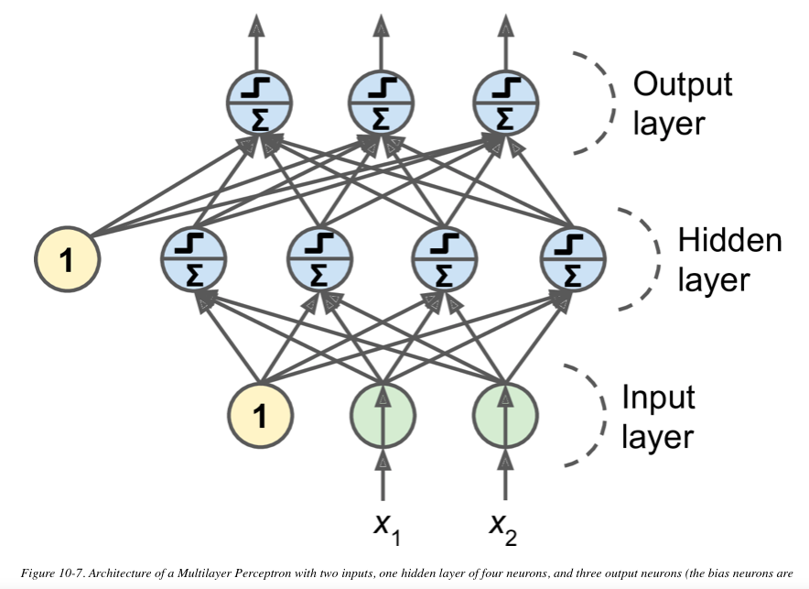
The MLP and Backpropagation
An MLP is composed of one (passthrough) input layer, one or more layers of TLUs, called hidden layers, and one final layer of TLUs called the output layer.
The layers close to the input layer are usually called the lower layers, and the ones close to the outputs are usually called the upper layers. Every layer except the output layer includes a bias neuron and is fully connected to the next layer.
When an ANN contains a deep stack of hidden layers, it is called a deep neural network (DNN).
The field of Deep Learning studies DNNs, and more generally models containing deep stacks of computations. Even so, many people talk about Deep Learning whenever neural networks are involved (even shallow ones).

Slide 19
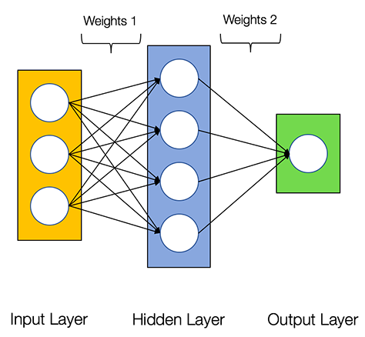
Artificial Neural Network (ANN)
Basically, an ANN comprises of the following components:
An input layer that receives data and pass it on (X)
A hidden layer or more
An output layer (Y)
Weights and biases between the layers (W, b)
A choice of activation function for each hidden layer.
There are several types of neural networks. We are going to create the feed-forward or perception neural networks. This type of ANN relays data directly from the front to the back.

Slide 20
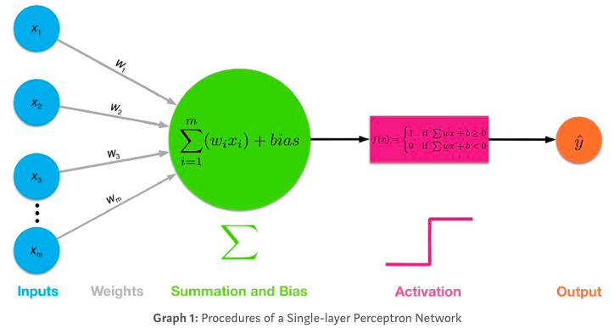
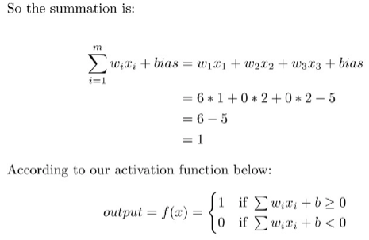
Example
Example: you need to decide whether to study DL or not?
If you will earn more money after mastering DL (Yes: 1, No: 0)
Is the relevant mathematics and programming easy (Yes: 1, No: 0)
You can work on DL immediately without the need for an expensive GPU (Yes: 1, No: 0)
Your preference is (1, 0 , 0)
Let’s go for w1 = 6, w2 = 2, w3 = 2. The larger the weight, the more influential the corresponding input is.
We’ll assume the threshold value = 5, which is equivalent to say that the bias term bias = -5.

Slide 21
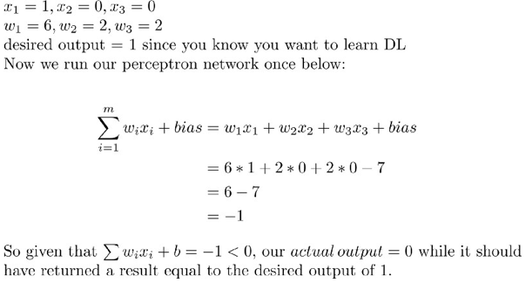
Adjusting weights
In a real DL model, we are given input data, which we can’t change.
The bias term is initialized before you train your neural networks model. Suppose the bias is 7.
Now, let’s assume the following input data so that (1)You will earn more money, (2) math and programming for DL will be hard, and (3) yes you have to spend $1400 for a GPU to work on DL, and most importantly, we assume that you actually want to learn deep learning, which we’ll name as the desired output (1, 0, 0 → 1 )
We can not change the input
We can not change the desired output
Lets assume : We can not change the bias
So ???

Slide 22
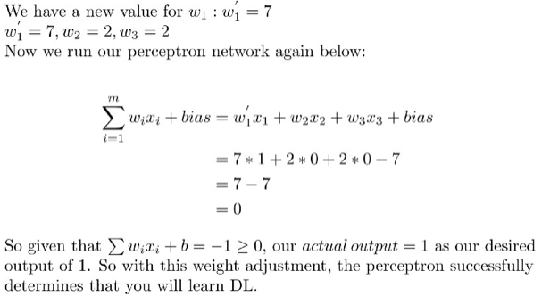
Adjusting the weights is the key to the learning process
Lets increase w1 to 7, without changing w2 and w3, then
backpropagation for the network is to learn from trials and errors

Slide 23
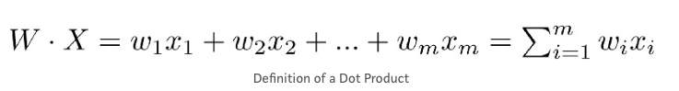
Learning ☺
If we start with random weights, perceptron will try to learn to adjust and find the ideal weights (w1 = 6, w2 = 2, w3 = 2)
With m features in input X, you need m weights to perform a dot product
With n hidden neurons in the hidden layer, you need n sets of weights (W1, W2, … Wn) for performing dot products
With 1 hidden layer, you perform n dot products to get the hidden output h: (h1, h2, …, hn)
Then it’s just like a single-layer perceptron, we use hidden output h: (h1, h2, …, hn) as input data that has n features, perform dot product with 1 set of n weights (w1, w2, …, wn) to get your final output y_hat.

Slide 24
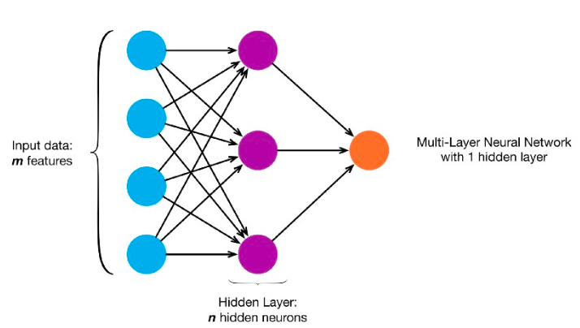
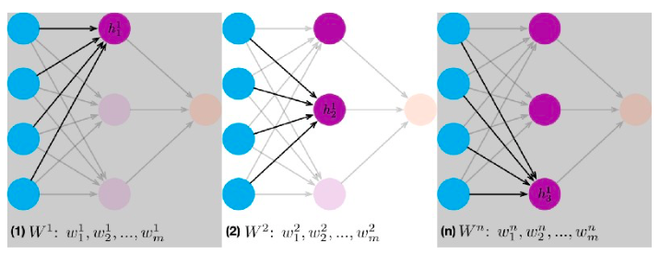

Slide 25
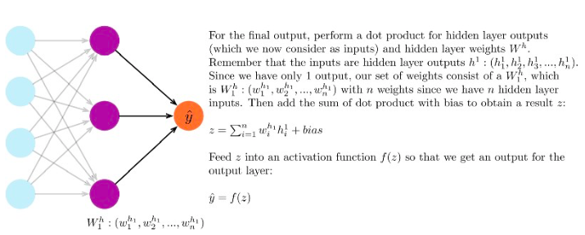

Slide 26
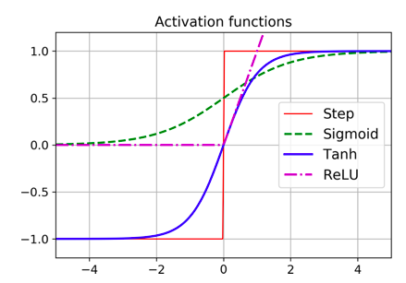
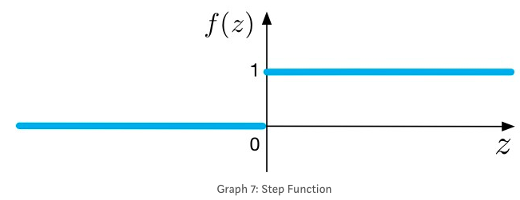
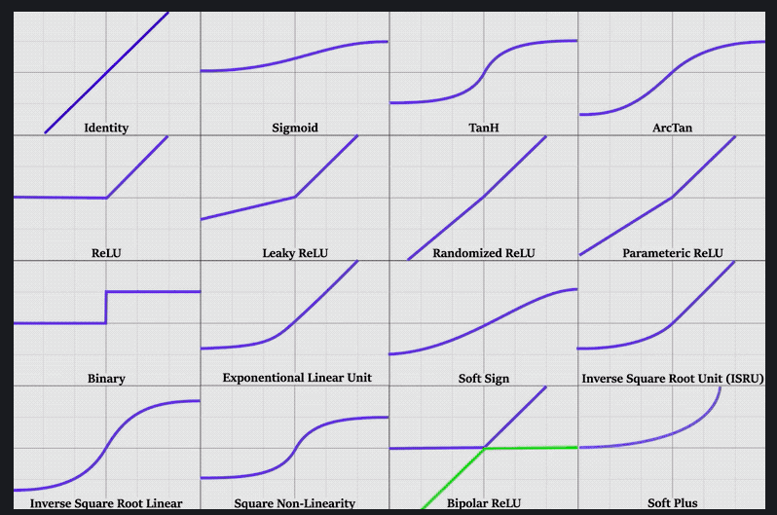
Activation Functions
step function
Sigmoid
TanH
ReLU
and more

Slide 27
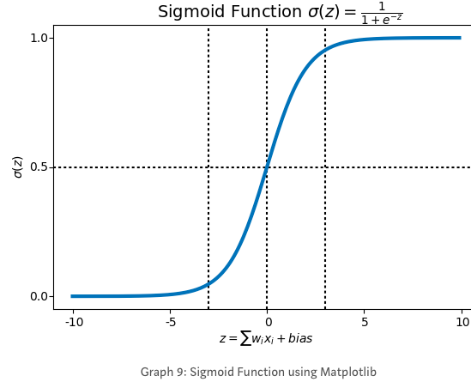
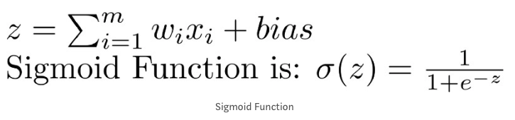
Sigmoid Activation function
Step Function (0 or 1) while sigmoid function is ?!?
Draws a characteristic “S”-shaped curve, as an activation function to the neural network.
This function can map any value to a value from 0 to 1. It will assist us to normalize the weighted sum of the inputs.
we want a learning algorithm that could improve our neural network by gradually changing the weights, not sudden jumps

Slide 28
Sigmoid function
Sigmoid function produces similar results to step function in that the output is between 0 and 1. The curve crosses 0.5 at z=0, which we can set up rules for the activation function, such as: If the sigmoid neuron’s output is larger than or equal to 0.5, it outputs 1; if the output is smaller than 0.5, it outputs 0.
Sigmoid function is smooth and it has a very nice and simple derivative of σ(z) * (1-σ(z)), which is differentiable everywhere on the curve. You don’t have to know how to derive it. No stress here.
If z is very negative, then the output is approximately 0; if z is very positive, the output is approximately 1; but around z=0 where z is neither too large or too small, we have relatively more deviation as z changes.
This non-linear activation function, when used by each neuron in a multi-layer neural network, produces a new “representation” of the original data

Slide 29
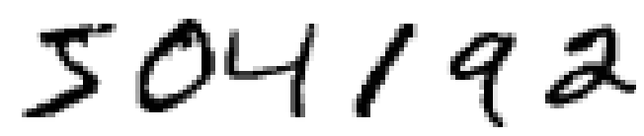
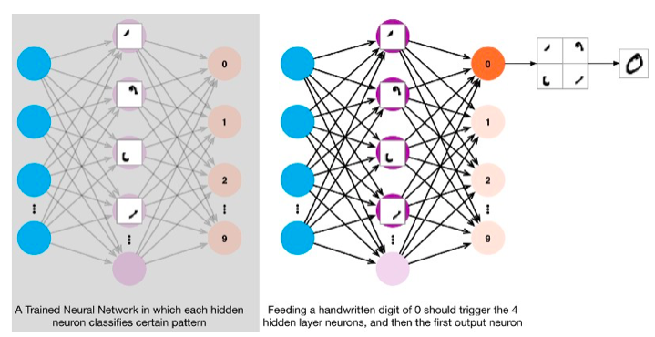
You and I have no clue what’s going on in the neural network until after the network is trained.
A trained neural network has weights which are optimized at certain values that make the best prediction or classification on our problem. It’s a black box.

Slide 30
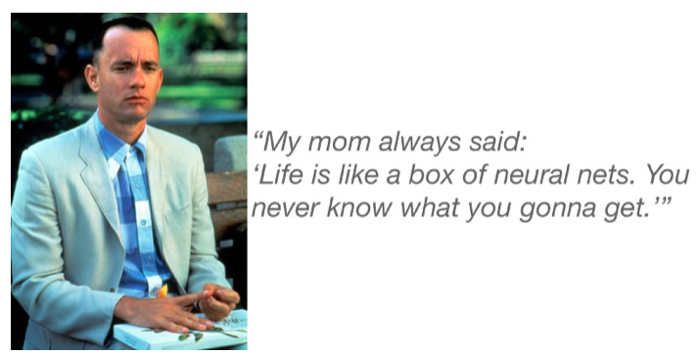
https://towardsdatascience.com/multi-layer-neural-networks-with-sigmoid-function-deep-learning-for-rookies-2-bf464f09eb7f

Slide 31
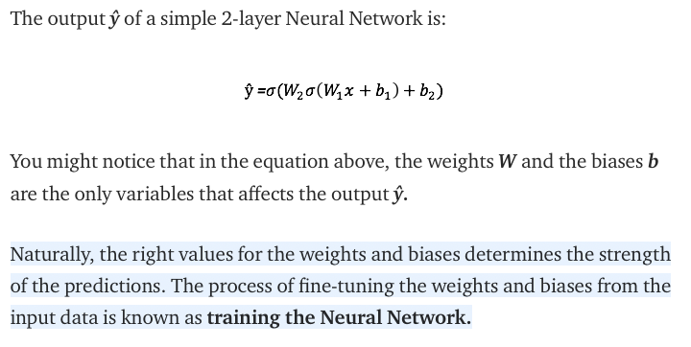
To sum up

Slide 32
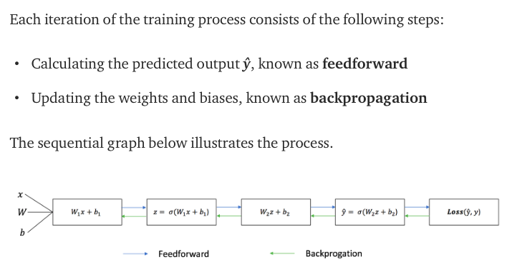

Slide 33
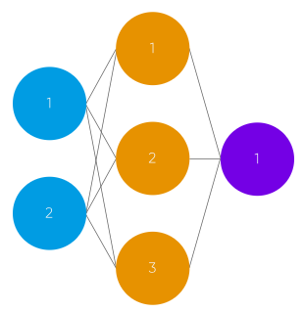
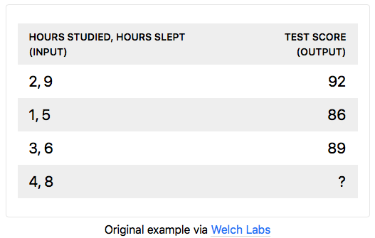
Building NN from Scratch
The neural network will model a single hidden layer with two inputs and one output.
In the network, we will be predicting the score of our exam based on the inputs of how many hours we studied and how many hours we slept the day before. Our test score is the output.

Slide 34
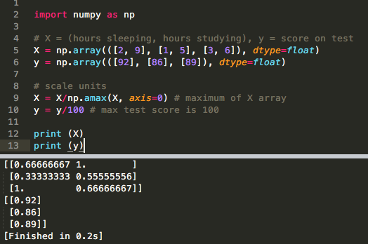
normalizing
We want all the input and output to have values between 0 and 1
scale our data by dividing by the maximum value for each variable.

Slide 35
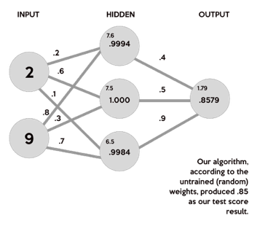
Random Weights
The input are (study 2 hours, sleep 9 hours)
We will generate random weights
0.2, 0.6, 0.1, 0.8 , 0.3, and 0.7
(2 * .2) + (9 * .8) = 7.6
(2 * .6) + (9 * .7) = 7.5
(2 * .1) + (9 * .7) = 6.5
We need to apply the activation function to
map the results from 0 to 1
There are many activation functions out there. The more popular ones - the sigmoid function.
.7

Slide 36
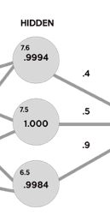
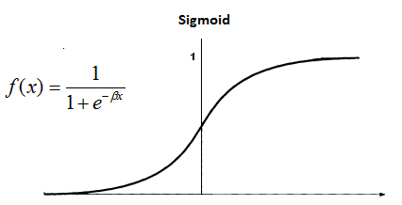
Sigmoid
S(7.6) = 0.999499799
S(7.5) = 1.000553084
S(6.5) = 0.998498818
(.9994 * .4) + (1.000 * .5) + (.9984 * .9) = 1.79832
S(1.79832) = .8579443067 → this is our first prediction
However, our target was 0.92.
Voila , THIS IS FEED FORWARD!!!

Slide 37



Coding!!

Slide 38
How to improve the prediction
Here’s a brief overview of how a simple feedforward neural network works:
Takes inputs as a matrix (2D array of numbers)
Multiplies the input by a set weights
Applies an activation function
Returns an output
Error is calculated by taking the difference from the desired output from the data and the predicted output. This creates our gradient descent, which we can use to alter the weights
The weights are then altered slightly according to the error.
To train, this process is repeated 1,000+ times. The more the data is trained upon, the more accurate our outputs will be.

Slide 39
Backpropagation
The “learning” of our network
Backpropagation is the heart of every neural network ☺
There is no pure backpropagation or pure feed-forward neural network.
Backpropagation is algorithm to train (adjust weight) of neural network.
Backpropagation works by using a loss (or cost) function to calculate how far the network was from the target output.

Slide 40

Backpropagation
Calculating error: One way of representing the loss function is by using the mean sum squared loss function:
our goal is to get it as close as we can to 0. That means we will need to have close to no loss at all. As we are training our network, all we are doing is minimizing the loss.
To figure out which direction to alter our weights, we need to find the rate of change of our loss with respect to our weights. In other words, we need to use the derivative of the loss function to understand how the weights affect the input. Here comes: gradient descent
n: number of observations

Slide 41


Gradient descent
Minimizing any function means finding the deepest valley in that function.
Analogically this can be seen as, walking down into a valley, trying to find gold(the lowest error value).
Using calculus, we know that the slope of a function is the derivative of the function with respect to a value. This slope always points to the nearest valley!
Now that we have found the direction we need to increment/decrement the weight, we need to find how much !!!. Here, we use the Learning Rate.
can be learned mostly by trial and error.

Slide 42


Optimizers
Optimizers is how the neural networks learn, using backpropagation to calculate the gradients.

Slide 43
Here how we will compute the change of our weights in our example
Take the difference of the predicted output and the actual output (y)
o_error = y - o # error in output
Apply the derivative of our sigmoid activation function to the output layer error. We call this result the delta output sum.
The derivative of sigmoid function is simply sigmoid(x) * sigmoid(1-x).
o_delta = o_error * sigmoidPrime(o)
Use the delta output sum of the output layer error to figure out how much our z² (hidden) layer contributed to the output error by performing a dot product with our second weight matrix. We can call this the z² error.
z2_error = o_delta.dot(W2.T) T(Transpose)
Calculate the delta output sum for the z² layer by applying the derivative of our sigmoid activation function (just like previous steps).
Adjust the weights for the first layer by performing a dot product of the input layer with the hidden (z²) delta output sum. For the second layer, perform a dot product of the hidden(z²) layer and the output (o) delta output sum.

Slide 44

The backpropagation code

Slide 45


Slide 46




Slide 47

Learning rule for adjusting weights
This is called the Perceptron convergence theorem

Slide 48

the Perceptron learning algorithm strongly resembles Stochastic Gradient Descent

Slide 49

KERAS
It is a great way to start experimenting with neural networks without having to implement every layer and piece on your own. For example Tensorflow is a great machine learning library, but you have to implement a lot of boilerplate code to have a model running.
pip install keras
The Sequential model is a linear stack of layers, where you can use the large variety of available layers in Keras. The most common layer is the Dense layer which is your regular densely connected neural network layer with all the weights and biases that you are already familiar with.
It was released as an open source project in March 2015
The most popular Deep Learning library, after Keras and TensorFlow, is Facebook’s PyTorch library.

Slide 50
Tesorflow or Pytorch
PyTorch’s popularity grew exponentially in 2018, largely thanks to its simplicity and excellent documentation, which were not TensorFlow 1.x’s main strengths.
However, TensorFlow 2 is arguably just as simple as PyTorch, as it has adopted Keras as its official high-level API and its developers have greatly simplified and cleaned up the rest of the API. The documentation has also been completely reorganized, and it is much easier to find what you need now.

Slide 51
Build a model
from keras.models import Sequential
from keras.layers import Dense, Dropout, Activation
model = Sequential()
The first thing to get right is to ensure the input layer has the right number of inputs.
How do we know the number of layers and their types?
This is a very hard question. There are heuristics that we can use and often the best network structure is found through a process of trial and error experimentation.
Generally, you need a network large enough to capture the structure of the problem if that helps at all.

Slide 52

Fully connected layers are defined using the Dense class. We can specify the number of neurons in the layer as the first argument, the initialization method as the second argument as init and specify the activation function using the activation argument.
For our previous example about iris flowers dataset. We have 4 features and 3 output classes

Slide 53
The network topology of this simple one-layer neural network can be summarized as:
4 input → (1 hidden layer with 8 neurons) → 3 output
# create model
model = Sequential()
model.add(Dense(8, input_dim=4, activation='relu'))
model.add(Dense(3, activation=‘softmax’))
model.compile(loss='categorical_crossentropy', optimizer='adam', metrics=['accuracy'])
model.fit(X, Y, epochs=150, batch_size=5)
Compiling the model uses the efficient numerical libraries under the covers such as Theano or TensorFlow. The backend automatically chooses the best way to represent the network for training and making predictions to run on your hardware, such as CPU or GPU or even distributed.
Again, these can be chosen experimentally by trial and error.

Slide 54

Notice that the Dense layer initialized the connection weights randomly, and the biases were initialized to zeros, which is fine. If you ever want to use a different initialization method, you can set kernel_initializer (kernel is another name for the matrix of connection weights) or bias_initializer when creating the layer.

Slide 55

This code requires some explanation. First, we use the "sparse_categorical_crossentropy" loss because we have sparse labels, and the classes are exclusive. If instead we had one target probability per class for each instance (such as one-hot vectors, e.g. [0., 0., 0., 1., 0., 0., 0., 0., 0., 0.] to represent class 3), then we would need to use the "categorical_crossentropy" loss instead.
If we were doing binary classification (with one or more binary labels), then we would use the "sigmoid" (i.e., logistic) activation function in the output layer instead of the "softmax" activation function, and we would use the "binary_crossentropy" loss.
Regarding the optimizer, "sgd" means that we will train the model using simple Stochastic Gradient Descent.

Slide 56
Optimizer, loss, and metrics
The loss function is used to optimize your model. This is the function that will get minimized by the optimizer.
A metric is used to judge the performance of your model. This is only for you to look at and has nothing to do with the optimization process.
model.compile(loss='categorical_crossentropy', optimizer='adam', metrics=['accuracy'])
sgd = SGD(lr=0.01, … )
model.compile(loss="mse", optimizer=sgd)

Slide 57
Epoch and batch size
Epoch: all the training examples have been processed a single time. An epoch is one forward pass and one backward pass of all training examples.
One epoch consists of one full training cycle on the training set. Once every sample in the set is seen, you start again - marking the beginning of the 2nd epoch.
Sometimes, you can’t pass the entire dataset into the neural net at once. So, you divide dataset into Number of Batches or sets or parts.
batch_size determines the number of samples in each mini batch. Its maximum is the number of all samples, which makes gradient descent accurate, the loss will decrease towards the minimum if the learning rate is small enough, but iterations are slower. Its minimum is 1, resulting in stochastic gradient descent: Fast but the direction of the gradient step is based only on one example, the loss may jump around. batch_size allows to adjust between the two extremes: accurate gradient direction and fast iteration. Also, the maximum value for batch_size may be limited if your model + data set does not fit into the available (GPU) memory.

Slide 58


Evaluation and validation
You can see that the training loss went down, which is a good sign, and the validation accuracy reached 89.26% after 30 epochs. That’s not too far from the training accuracy, so there does not seem to be much overfitting going on.

Slide 59
The training set performance ends up beating the validation performance, as is generally the case when you train for long enough.
You can tell that the model has not quite converged yet, as the validation loss is still going down, so you should probably continue training. It’s as simple as calling the fit() method again, since Keras just continues training where it left off (you should be able to reach close to 89% validation accuracy).
If you are not satisfied with the performance of your model, you should go back and tune the hyperparameters. The first one to check is the learning rate. If that doesn’t help, try another optimizer.
If the performance is still not great, then try tuning model hyperparameters such as the number of layers, the number of neurons per layer, and the types of activation functions to use for each hidden layer. You can also try tuning other hyperparameters, such as the batch size (it can be set in the fit() method using the batch_size argument, which defaults to 32).

Slide 60


Finding best parameters!

Slide 61

Another example
https://machinelearningmastery.com/tutorial-first-neural-network-python-keras/

Slide 62


Slide 63


Every time you create a checkpoint, you also create a hidden file.
A simpler check-point strategy is to save the model weights to the same file, if and only if the validation accuracy improves.

Slide 64
Or use the EarlyStopping callback. It will interrupt training when it measures no progress on the validation set for a number of epochs and it will optionally roll back to the best model.
You can combine both callbacks to save checkpoints of your model (in case your computer crashes) and interrupt training early when there is no more progress (to avoid wasting time and resources)
Training will stop when the chosen performance measure stops improving. To discover the training epoch on which training was stopped, the “verbose” argument can be set to 1. Once stopped, the callback will print the epoch number.
The first sign of no further improvement may not be the best time to stop training. The model may has no improvement or even get slightly worse before getting much better.
We can add a delay to the trigger in terms of the number of epochs on which we would like to see no improvement. This can be done by setting the “patience” argument.

Slide 65
Backpropagation problems
The backpropagation algorithm works by going from the output layer to the input layer, propagating the error gradient along the way.
Once the algorithm has computed the gradient of the cost function with regard to each parameter in the network, it uses these gradients to update each parameter with a Gradient Descent step.
Unfortunately, gradients often get smaller and smaller as the algorithm progresses down to the lower layers.
As a result, the Gradient Descent update leaves the lower layers’ connection weights virtually unchanged, and training never converges to a good solution.
We call this the vanishing gradients problem.
In some cases, the opposite can happen: the gradients can grow bigger and bigger until layers get insanely large weight updates and the algorithm diverges. This is the exploding gradients problem.
More generally, deep neural networks suffer from unstable gradients; different layers may learn at widely different speeds.

Slide 66
Problems solved with activation function
Some researchers said that the problems with unstable gradients were in part due to a poor choice of activation function.
They had chosen to use roughly sigmoid activation functions
But it turns out that other activation functions behave much better in deep neural networks—in particular, the ReLU activation function, mostly because it does not saturate for positive values (and because it is fast to compute).
Unfortunately, the ReLU activation function is not perfect. It suffers from a problem known as the dying ReLUs: during training, some neurons effectively “die,” meaning they stop outputting anything other than 0.
In some cases, you may find that half of your network’s neurons are dead, especially if you used a large learning rate. A neuron dies when its weights get tweaked in such a way that the weighted sum of its inputs are negative for all instances in the training set.

Slide 67


To solve ReLU problem
To solve this problem, you may want to use a variant of the ReLU function, such as the leaky ReLU. This function is defined as LeakyReLU_{α}(z) = max(αz, z)
The hyperparameter α defines how much the function “leaks”: it is the slope of the function for z < 0 and is typically set to 0.01. This small slope ensures that leaky ReLUs never die; they can go into a long coma, but they have a chance to eventually wake up
A new activation function called the exponential linear unit (ELU) also outperformed ReLU. The main drawback of the ELU activation function is that it is slower to compute than the ReLU function.

Slide 68

Batch Normalization
To reduce the danger of the vanishing/exploding gradients problems
The technique consists of adding an operation in the model just before or after the activation function of each hidden layer. This operation simply zero-centers and normalizes each input, then scales and shifts the result using two new parameter vectors per layer: one for scaling, the other for shifting. In other words, the operation lets the model learn the optimal scale and mean of each of the layer’s inputs.
Finally, like a gift that keeps on giving, Batch Normalization acts like a regularizer, reducing the need for other regularization techniques
BatchNormalization has become one of the most-used layers in deep neural networks, to the point that it is often omitted in the diagrams, as it is assumed that BN is added after every layer.

Slide 69
Gradient Clipping
Another popular technique to reduce the exploding gradients problem is to clip the gradients during backpropagation so that they never exceed some threshold.
It is possible for the updates to the weights (in the backpropagartion) to be so large that the weights either overflow or underflow their numerical precision. In practice, the weights can take on the value of an “NaN” or “Inf” when they overflow or underflow and for practical purposes the network will be useless from that point forward, forever predicting NaN values as signals flow through the invalid weights.
Gradient clipping involves forcing the gradient values (element-wise) to a specific minimum or maximum value if the gradient exceeded an expected range.

Slide 70
Reusing Pretrained Layers
It is generally not a good idea to train a very large DNN from scratch: instead, you should always try to find an existing neural network that accomplishes a similar task to the one you are trying to tackle.
Then reuse the lower layers of this network. This technique is called transfer learning. It will not only speed up training considerably, but also require significantly less training data.
Suppose you have access to a DNN that was trained to classify pictures into 100 different categories, including animals, plants, vehicles, and everyday objects. You now want to train a DNN to classify specific types of vehicles. These tasks are very similar, even partly overlapping, so you should try to reuse parts of the first network.
The output layer of the original model should usually be replaced because it is most likely not useful at all for the new task, and it may not even have the right number of outputs for the new task.
Similarly, the upper hidden layers of the original model are less likely to be as useful as the lower layers, since the high-level features that are most useful for the new task may differ significantly from the ones that were most useful for the original task. You want to find the right number of layers to reuse.

Slide 71


Slide 72

How transfer learning works?
Try freezing all the reused layers first (i.e., make their weights non-trainable so that Gradient Descent won’t modify them), then train your model and see how it performs.
Then try unfreezing one or two of the top hidden layers to let backpropagation tweak them and see if performance improves. The more training data you have, the more layers you can unfreeze. It is also useful to reduce the learning rate when you unfreeze reused layers: this will avoid wrecking their fine-tuned weights.
If you still cannot get good performance, and you have little training data, try dropping the top hidden layer(s) and freezing all the remaining hidden layers again.
Example: you need to load model A and create a new model based on that model’s layers. Let’s reuse all the layers except for the output layer:
Note that model_A and model_B_on_A now share some layers. When you train model_B_on_A, it will also affect model_A. If you want to avoid that, you need to clone model_A before you reuse its layers.

Slide 73


Slide 74
Faster Optimizers
Training a very large deep neural network can be painfully slow.
So far we have seen four ways to speed up training:
applying a good initialization strategy for the connection weights
using a good activation function
using Batch Normalization
and reusing parts of a pretrained network
Another huge speed boost comes from using a faster optimizer than the regular Gradient Descent optimizer.
The most popular algorithms: momentum optimization, Nesterov Accelerated Gradient, AdaGrad, RMSProp, and finally Adam and Nadam optimization.

Slide 75

Momentum
GD
Momentum
β, called the momentum, which must be set between 0 (high friction) and 1 (no friction). A typical momentum value is 0.9.
Gradient Descent goes down the steep slope quite fast, but then it takes a very long time to go down the valley. In contrast, momentum optimization will roll down the valley faster and faster until it reaches the bottom (the optimum).
The one drawback of momentum optimization is that it adds yet another hyperparameter to tune. However, the momentum value of 0.9 usually works well in practice and almost always goes faster than regular Gradient Descent.

Slide 76


Learning Rate Scheduling
Finding a good learning rate is very important.
If you set it much too high, training may diverge
If you set it too low, training will eventually converge to the optimum, but it will take a very long time.
It can also be beneficial to start with a low learning rate, increase it, then drop it again. These strategies are called learning schedules
The mathematical form of time-based decay is lr = lr0/(1+kt) where lr, k are hyperparameters and t is the iteration number.
When you save a model, the optimizer and its learning rate get saved along with it.
https://towardsdatascience.com/learning-rate-schedules-and-adaptive-learning-rate-methods-for-deep-learning-2c8f433990d1

Slide 77

Avoiding Overfitting Through Regularization
Popular regularization techniques for neural networks:
ℓ₁and ℓ₂ regularization,
dropout,
and max-norm regularization.
Dropout is one of the most popular regularization techniques for deep neural networks.
At every training step, every neuron (including the input neurons, but always excluding the output neurons) has a probability p of being temporarily “dropped out,” meaning it will be entirely ignored during this training step, but it may be active during the next step
If you observe that the model is overfitting, you can increase the dropout rate. Conversely, you should try decreasing the dropout rate if the model underfits the training set.

Slide 78
Tensorflow
Tensorflow has been the most popular open source software library for high performance numerical computation which became highly popular among Machine learning practitioners ever since it was open sourced by Google (Nov 2015).
It includes highly efficient C++ implementations of many ML operations
TensorFlow offers APIs (such as Keras and TF.Learn) for beginners and experts to develop for desktop, mobile, web, and cloud.
You can use the TensorFlow library do to numerical computations, these computations are done with data flow graphs. In these graphs, nodes represent mathematical operations, while the edges represent the data, which usually are multidimensional data arrays or tensors, that are communicated between these edges.
It is possible to break up the graph into several chunks and run them in parallel across multiple CPUs or GPUs.
TensorFlow supports distributed computing, so you can train colossal neural networks on humongous training sets in a reasonable amount of time by splitting the computations across hundreds of servers.

Slide 79

Tensor!
Tensors are just multidimensional arrays, that allows you to represent data having higher dimensions.
In general, Deep Learning you deal with high dimensional data sets where dimensions refer to different features present in the data set. In fact, the name “TensorFlow” has been derived from the operations which neural networks perform on tensors. It’s literally a flow of tensors.

Slide 80

What is Tensorflow
TensorFlow is a library based on Python that provides different types of functionality for implementing Deep Learning Models. As discussed earlier, the term TensorFlow is made up of two terms – Tensor & Flow:

Slide 81
Code Basics
pip3 install --upgrade tensorflow
Basically, the overall process of writing a TensorFlow program involves two steps:
Building a Computational Graph
Running a Computational Graph
Let me explain you the above two steps one by one:

Slide 82




Example
This code does not actually perform any computation, it just creates a computation graph.
In fact, even the variables are not initialized yet.
To evaluate this graph, you need to open a TensorFlow session and use it to initialize the variables and evaluate f.

Slide 83

Building a Computational Graph
A computational graph is a series of TensorFlow operations arranged as nodes in the graph. Each nodes take 0 or more tensors as input and produces a tensor as output.

Slide 84

Running a Computational Graph
Session places the graph operations onto Devices, such as CPUs or GPUs, and provides methods to execute them.
A session encapsulates the control and state of the TensorFlow runtime i.e. it stores the information about the order in which all the operations will be performed and passes the result of already computed operation to the next operation in the pipeline.

Slide 85

Placeholder and Variables
A constant allows you to store a value.
A placeholder is simply a variable that we will assign data to at a later date. Basically, a placeholder is a promise to provide a value later or during runtime.
Placeholders are not initialized and contains no data.
One must provides inputs or feeds to the placeholder which are considered during runtime.
Executing a placeholder without input generates an error.

Slide 86


Linear Regression with TensorFlow
Linear Model
Output: [ 0. 0.40000001 0.80000007 1.20000005]

Slide 87


Loss Function – Model Validation for linear regression
Sum of Squared Error or SSE
90.24
we need to adjust our weights (W) and bias (b) so as to reduce the error that we are receiving.
TensorFlow provides optimizers that slowly change each variable in order to minimize the loss function or error. The simplest optimizer is gradient descent. It modifies each variable according to the magnitude of the derivative of loss with respect to that variable.

Slide 88

For Optimization GD
https://www.edureka.co/blog/tensorflow-tutorial/

Slide 89

Visualizing the Computational Graph with TensorBoard
TensorBoard is a visualization tool for analyzing data flow graphs. This can be useful for gaining better understanding of machine learning models.

Slide 90



An example from the book

Slide 91

Save the model

Slide 92
ch 10 and 11 from the new book is done ☺

Slide 93
references
https://pythonprogramming.net/neural-networks-machine-learning-tutorial/
https://towardsdatascience.com/introducing-deep-learning-and-neural-networks-deep-learning-for-rookies-1-bd68f9cf5883
https://towardsdatascience.com/multi-layer-neural-networks-with-sigmoid-function-deep-learning-for-rookies-2-bf464f09eb7f
https://enlight.nyc/projects/neural-network/
https://towardsdatascience.com/how-to-build-your-own-neural-network-from-scratch-in-python-68998a08e4f6
https://www.kdnuggets.com/2018/10/simple-neural-network-python.html
https://medium.com/@UdacityINDIA/how-to-build-your-first-neural-network-with-python-6819c7f65dbf
https://www.analyticsvidhya.com/blog/2017/05/neural-network-from-scratch-in-python-and-r/

